Slide 1
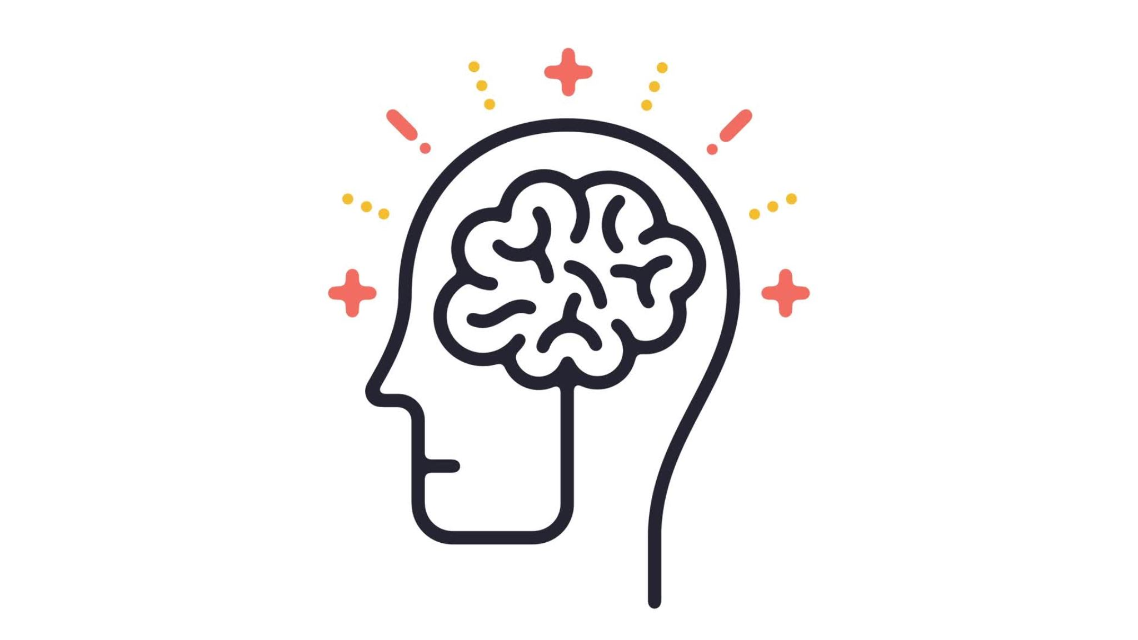
Introduction to Intelligent
By Olaleye Isaac

Slide 2
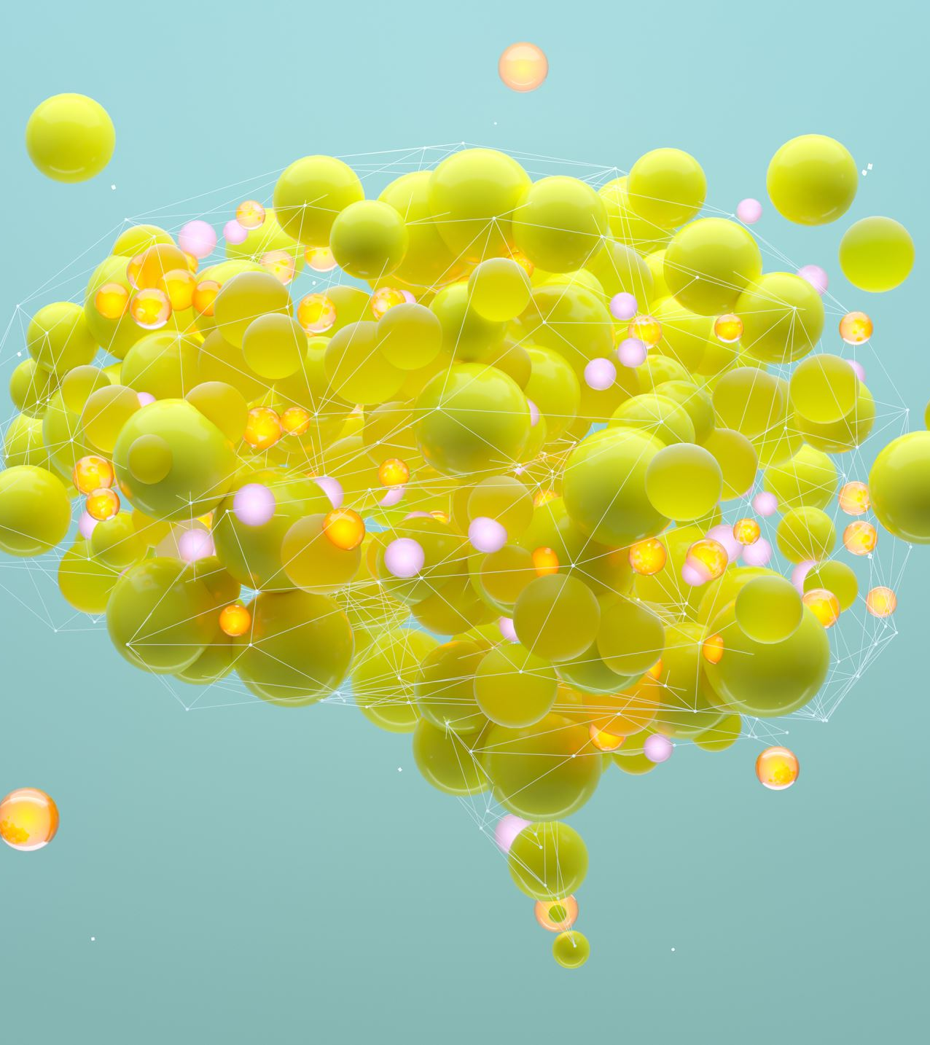
Definition of Intelligence
Intelligence refers to the ability to acquire, understand, and apply knowledge and skills. It encompasses reasoning, problem-solving, decision-making, learning, and adapting to new situations. Human intelligence, in particular, includes the capacity to think abstractly, comprehend complex ideas, and communicate effectively.

Slide 3
What Are Intelligent Systems?
Intelligent systems are machines or software that are designed to mimic certain cognitive functions of humans. These systems can perform tasks such as reasoning, learning, and decision-making. They operate with a level of autonomy and often involve artificial intelligence (AI) techniques like machine learning, natural language processing, and computer vision to process information and make decisions based on the environment or data provided.

Slide 4
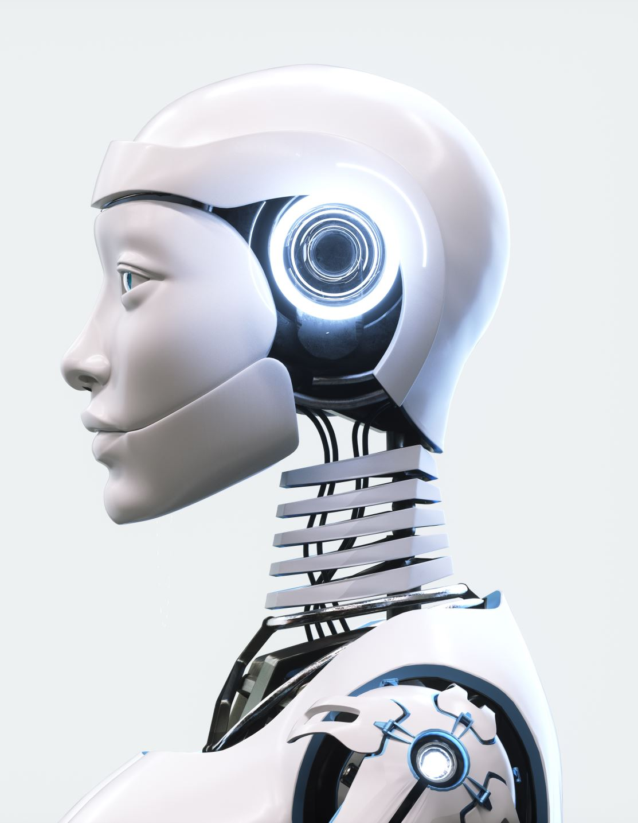
Will an Intelligent System Match Human Intelligence?
While intelligent systems can perform specific tasks at or beyond human-level capability (e.g., chess or complex calculations), general human intelligence remains unmatched. Human intelligence is broader and involves emotions, intuition, and creativity, which machines currently cannot fully replicate. However, advancements in AI are making it possible for systems to excel in more complex tasks, but reaching true human-level general intelligence remains a challenge.

Slide 5
Examples of Intelligent Systems in Different Areas
Healthcare: Diagnostic systems like IBM’s Watson assist doctors by analyzing vast amounts of medical data to provide recommendations.
Transportation: Self-driving cars such as those developed by Tesla use AI to navigate roads, avoid obstacles, and drive safely.
Finance: AI-driven trading systems execute stock trades based on algorithmic strategies, often outperforming human traders.
Customer Service: Chatbots powered by natural language processing (NLP) help handle customer inquiries efficiently.
Robotics: Autonomous robots, used in manufacturing and space exploration, perform tasks in environments that are hazardous or inaccessible to humans.

Slide 6
How Do We Qualify a System as Intelligent?
Having or showing (usually a high degree of) understanding, clever, quickness of mind.
Endowed with the faculty of reason; having or showing highly developed mental faculties; well informed; knowing, aware (of).
Having or showing powers of learning, reasoning, or understanding, especially to a high degree.

Slide 7
What Makes a System Intelligent?
Computing technology.
Intelligent/smart algorithm.
Communication technology.
Platform.
Sensor technology.

Slide 8
How Does an Intelligent System See the World or Is Aware of Its Environment?
Intelligent systems perceive their environment through sensors and input devices, such as cameras, microphones, and proximity sensors. They process the raw input using AI algorithms and models to extract meaningful information about the world. For example, in computer vision, an intelligent system can detect objects, recognize faces, or track movements by analyzing images or video feeds. Similarly, in natural language processing, the system understands human language input by analyzing patterns in speech or text.

Slide 9
Challenges in Building an Intelligent System
Data Quality: Intelligent systems require vast amounts of high-quality, well-labeled data to learn effectively.
Complexity of Human Cognition: Replicating human-like reasoning, creativity, and emotional intelligence is difficult.
Ethics and Bias: Systems can unintentionally inherit biases present in the data used to train them, leading to unfair outcomes.
Scalability: Ensuring that intelligent systems perform well under various conditions and for large-scale applications is a technical hurdle.
Security: Intelligent systems must be protected against attacks that could manipulate their behavior or access sensitive data.
Biologically inspired algorithms.
Sensor Systems

Slide 10
Possible Future Intelligent Systems
The future of intelligent systems holds exciting prospects:
General AI: Systems that mimic human cognitive abilities across a broad range of tasks may emerge.
AI-Driven Healthcare: Predictive AI models may lead to breakthroughs in personalized medicine, early diagnosis, and treatment plans.
Advanced Robotics: Autonomous robots that can interact with humans safely and effectively, potentially serving as personal assistants, rescue workers, or companions.
Smart Cities: Intelligent systems could optimize urban planning, traffic control, waste management, and energy distribution, leading to more sustainable and efficient cities.
Education: AI-driven tutors that can provide personalized learning experiences, adjusting content and difficulty based on a student's progress.

